Slide 1

Predictive Modelling For Duke Energy Customers
Dylan Demo, Denny Dunmire, Jack Roettig, Wenyi Yang

Slide 2
Overview
Main objective:
Determine what variables can be used to best predict kWh usage across given customer data, then fit a resulting model
General Modelling Process:
Clean the data
Start simple with a small amount of variables
Measure model strength using training vs testing data (80:20 Split)
After starting simple, attempt various combinations of adding, swapping, creating, or transforming variables; continue applying training-testing split
The models discussed throughout this presentation serve as a general guide to visualize the steps in our process

Slide 3
Data Wrangling
Combined data sets
Removed customers 67 and 148 due to missing or incorrect entries
Removed NAs from kWh and Outdoor Temperature variables
Created new columns for factors which included: Date, Time, Day of Week, Weekend, Season, Working Hours, Night vs Day
Season Definition
Winter: December 21st - March 18th
Spring: March 19th - June 18th
Summer: June 19th - September 20th
Fall: September 21st - December 20th
Night vs Day Definition
Night: 10pm - 6am
Day: 6am - 10pm

Slide 4
Measuring Model Strength With Training vs Testing data
Each customer's data was randomly split into 80% training data and 20% testing data
After fitting a model for the training data and comparing to the testing data, we then calculated the MSE:
MSE = Σ(testing values – predicted values)² / # of testing values
After fitting the model for all 198 customers (excluding 67 and 148), the mean of all customer MSE's was calculated:
Mean MSE = Σ(customer MSE) / # of customers
This was the main metric used to determine model strength

Slide 5
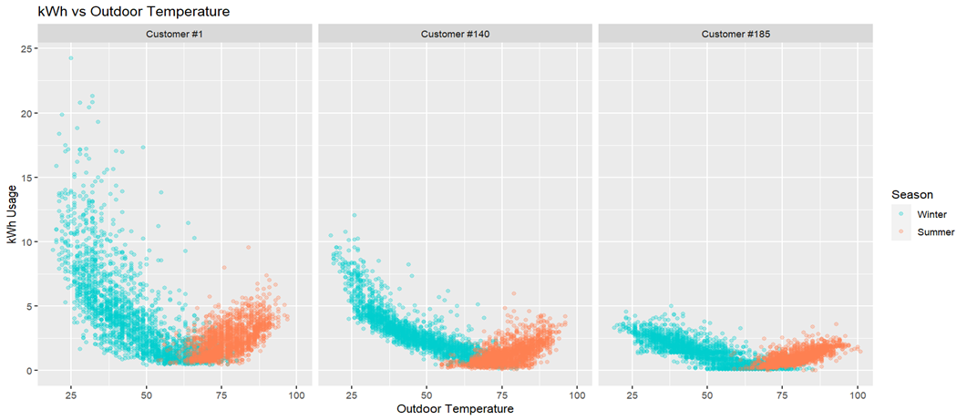
Expected Trend Across Customers
A few (not all) customers who follow the expected trend of:
High kWh usage during winter and summer
Higher variation in the winter than summer
For the sake of reducing variation, fall and spring observations were not included

Slide 6
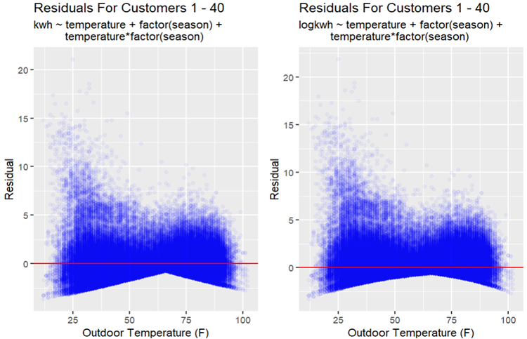
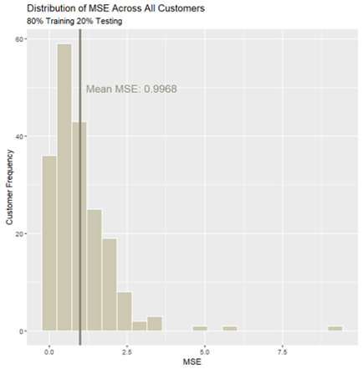
First Steps: Linear Model
MLR:
kwh ~ temperature + factor(season) + temperature*factor(season)
Interaction included due to apparent differences in slopes across seasons
Mean MSE of .9968 after training-testing split

Slide 7
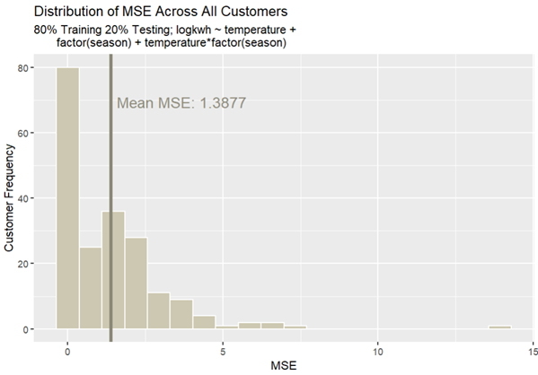
Log Transformation
Log Transformation on kWh:
logkwh ~ temperature + factor(season) + temperature*factor(season)
Mean MSE of 1.3877 after training-testing split
Difficulty in targeting winter variation

Slide 8
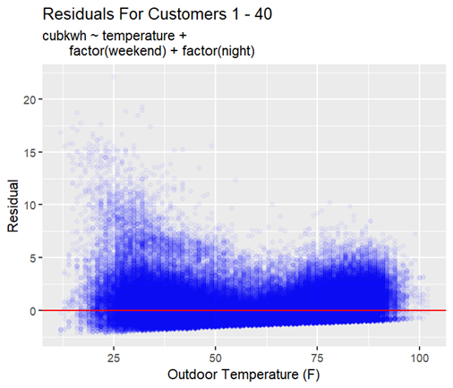
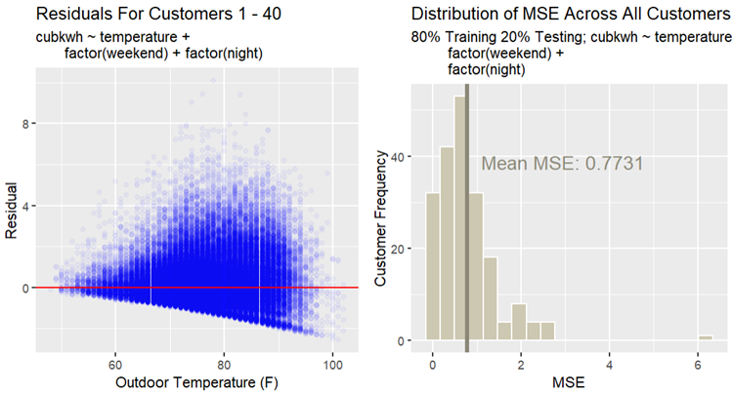
Cube Root Transformation
Cube Root Transformation on kWh:
Cubkwh ~ temperature + factor(weekend) + factor(night)
Mean MSE of .7731 after training-testing split
Lowest mean MSE out of our models, but uses summer observations only

Slide 9
Final Conclusions
While ending up with a mean MSE of .7731 in our cube root model, it's hard to compare it against the other models we've tested since the model included only summer observations. Aside from this, our linear model had relatively low MSE of .9968 when summer and winter observations were included
Overall struggles:
Decreasing variation in the winter
Finding/creating useful explanatory variables
A major learning experience!

Slide 10
Limitations
Fourier Transformation:
Lack of experience in transforming temperature variable
Demographic Data:
Home_year_built: 100 customers with a year value of “0” and 29 customers with “1990"; determined as incorrect or missing
Dwelling_type: 18 customers with missing values. Discussed that levels “Multiple Family” and “Single Family” were likely inaccurate
Square_footage: 100 customers with a square footage value of “0"; determined as missing
city, state, and owner_renter: not included due to opinions on usefulness

Slide 11
Thank You

